Slide 1
Decision Trees and Machine Learning in R
Daniel Izaguirre

Slide 2

Relevance to course
The R programming language is a statistical computing programming language.
It can be used to do data analysis and data mining, which can then be implemented in machine learning.
It can be used to create predictive models by “training” models.

Slide 3
How?
Seek a particular outcome which could have significance. A question… Why is…
Find Data
Clean/prepare the data for analysis
Develop a model or algorithm
R provides many models/algorithms.
Evaluate the accuracy of the model

Slide 4
For this project:
Prediction Question: what factors determine high Salary?
Sample Data: Human Resources Dataset
Variables
Response : Salary
Predictors: Satisfaction Level, Last Evaluation, # of Projects, Average Monthly Hours, time spent at the company, work accidents, promotions within the last 5 years, and job type
Algorithms used: Decision tree, and random forest.

Slide 5
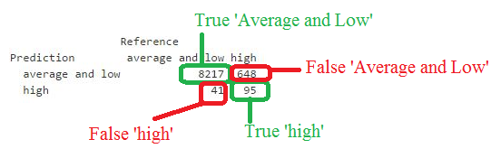
Interpreting Results of the models

Slide 6
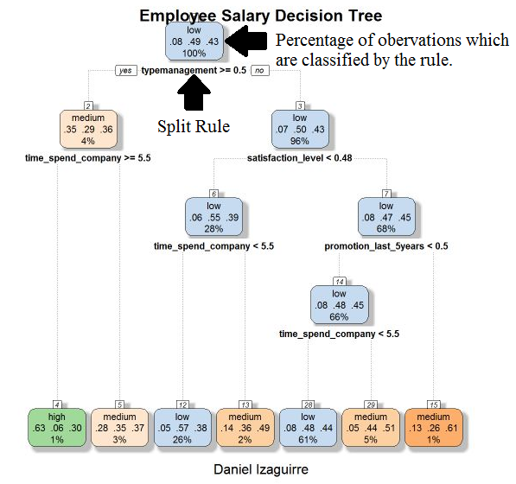
Interpreting the Decision Tree

